Slide 1
Hierarchical Design
Access
Distribution
Core

Slide 2
Resources
Design Guides
http://www.cisco.com/c/en/us/solutions/enterprise/design-zone-campus/design-guide-listing.html
Campus 3.0 architecture
http://www.cisco.com/c/en/us/td/docs/solutions/Enterprise/Campus/campover.html
Campus design routed access layer
http://www.cisco.com/c/en/us/td/docs/solutions/Enterprise/Campus/routed-ex.html

Slide 3
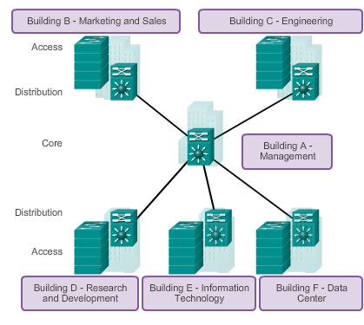
Hierarchical Network Design Network Hierarchy
Access layer – Provides workgroup or user access to the network.
Distribution layer – Provides policy-based connectivity.
Core layer – Provides fast transport between distribution switches.
Notes:
1.1.2.1 Network Hierarchy

Slide 4
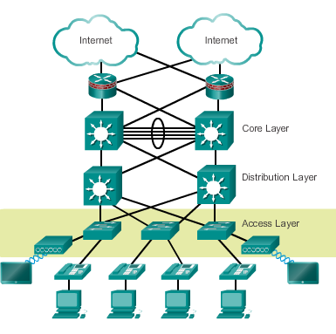
Hierarchical Network Design Access Layer
Layer 2 switching
High availability
Port security
QoS classification and marking and trust boundaries
Address Resolution Protocol (ARP) inspection
Virtual access control lists (VACLs)
Spanning tree
Power over Ethernet (PoE) and auxiliary VLANs for VoIP
Notes:
1.1.2.2 The Access Layer
ARP inspection – validates ARP packets to mitigate spoofing etc

Slide 5
Hierarchical Network Design Distribution Layer
Aggregation of LAN or WAN links
Policy-based security in the form of access control lists (ACLs) and filtering
Routing services between LANs and VLANs and between routing domains (e.g., EIGRP to OSPF)
Redundancy and load balancing
A boundary for route aggregation and summarization configured on interfaces toward the core layer
Notes:
1.1.2.3 The Distribution Layer

Slide 6
Hierarchical Network Design Core Layer
Provides high-speed switching (i.e., fast transport)
Provides reliability and fault tolerance
Scales by using faster, and not more, equipment
Avoids CPU-intensive packet manipulation caused by security, inspection, quality of service (QoS) classification, or other processes
Notes:
1.1.2.4 The Core Layer

Slide 7
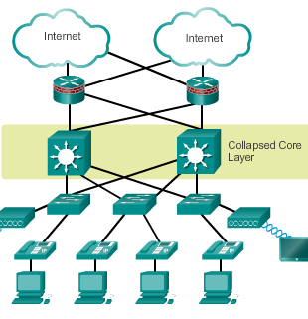
Hierarchical Network Design Two-Tier Collapsed Core Design
A two-tier hierarchical “collapsed core” is when the distribution layer and core layer functions are implemented by a single device.
Used by smaller businesses to reduce network cost while maintaining most of the benefits of the three-tier hierarchical model.
Notes:
1.1.2.5 Two-Tier Collapsed Core Design

Slide 8
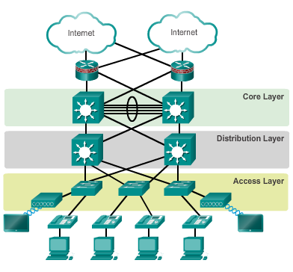
Hierarchical Network Design Hierarchical Network Design
This model divides the network functionality into three distinct layers.
Notes:
1.1.1.3 Hierarchical Network Design

Slide 9
Hierarchical Network Design Failure Domains
Failure Domains are areas of a network that are impacted when a critical device or network service experiences problems.
Redundant links and enterprise class equipment minimize disruption of network.
Smaller failure domains reduce the impact of a failure on company productivity.
Smaller failure domains also simplify troubleshooting.
Switch block deployment – each switch block acts independently of the others. Failure of a single device does not impact the whole network.
Notes:
1.1.1.5 Failure Domains

Slide 10
Expanding the Network Designing for Scalability
Use expandable, modular equipment or clustered devices.
Include design modules that can be added, upgraded, and modified, without affecting the design of the other functional areas of the network.
Create a hierarchical addressing scheme.
Use routers or multilayer switches to limit broadcasts and filter traffic.
Notes:
1.1.2.1 Design for Scalability

Slide 11
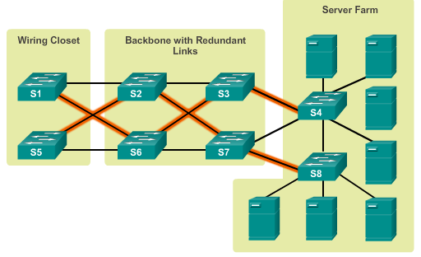
Expanding the Network Planning for Redundancy
Installing duplicate equipment
Providing redundant paths
Notes:
1.1.2.2 Planning for Redundancy

Slide 12
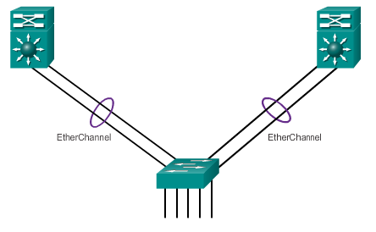
Expanding the Network Increasing Bandwidth
Link aggregation increases the amount of bandwidth between devices by creating one logical link made up of several physical links.
EtherChannel is a form of link aggregation used in switched networks.
Notes:
1.1.2.3 Increasing Bandwidth

Slide 13
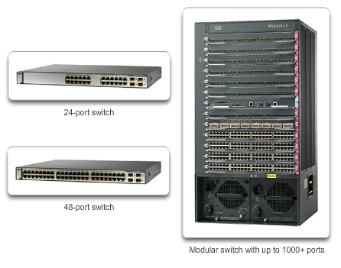
Switch Hardware Port Density
Notes:
1.2.1.2 Port Density

Slide 14
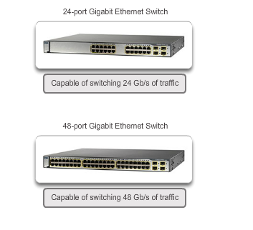
Switch Hardware Forwarding Rates
The processing capabilities of a switch are rated by how much data the switch can process per second.
Notes:
1.2.1.3 Forwarding Rates

Slide 15
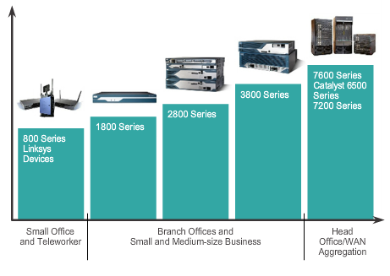
Router Hardware Router Hardware
Fixed configuration – Built-in interfaces.
Modular – Slots allow different interfaces to be added.
Notes:
1.2.2.3 Router Hardware

